Slide 1

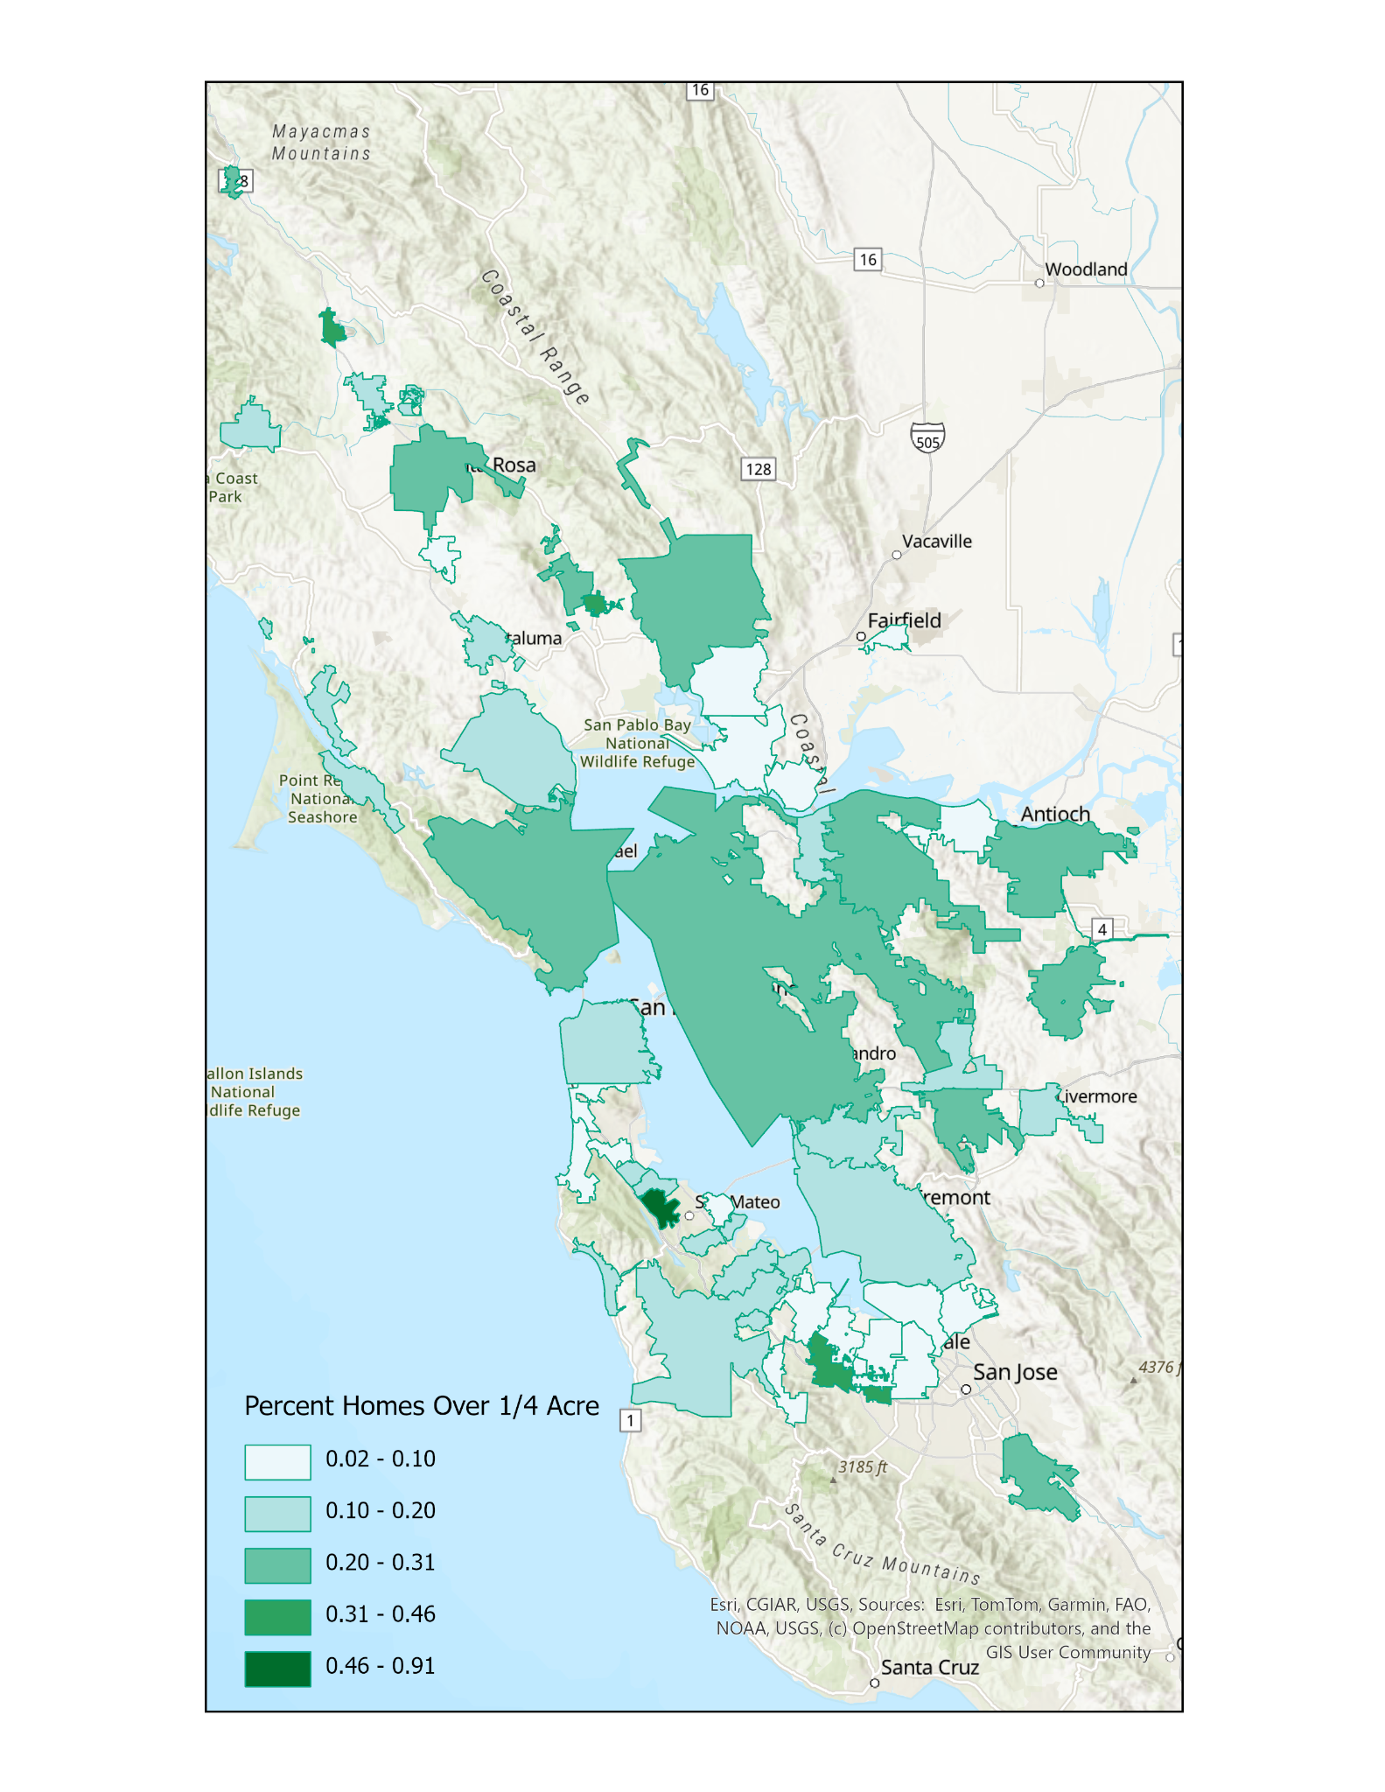
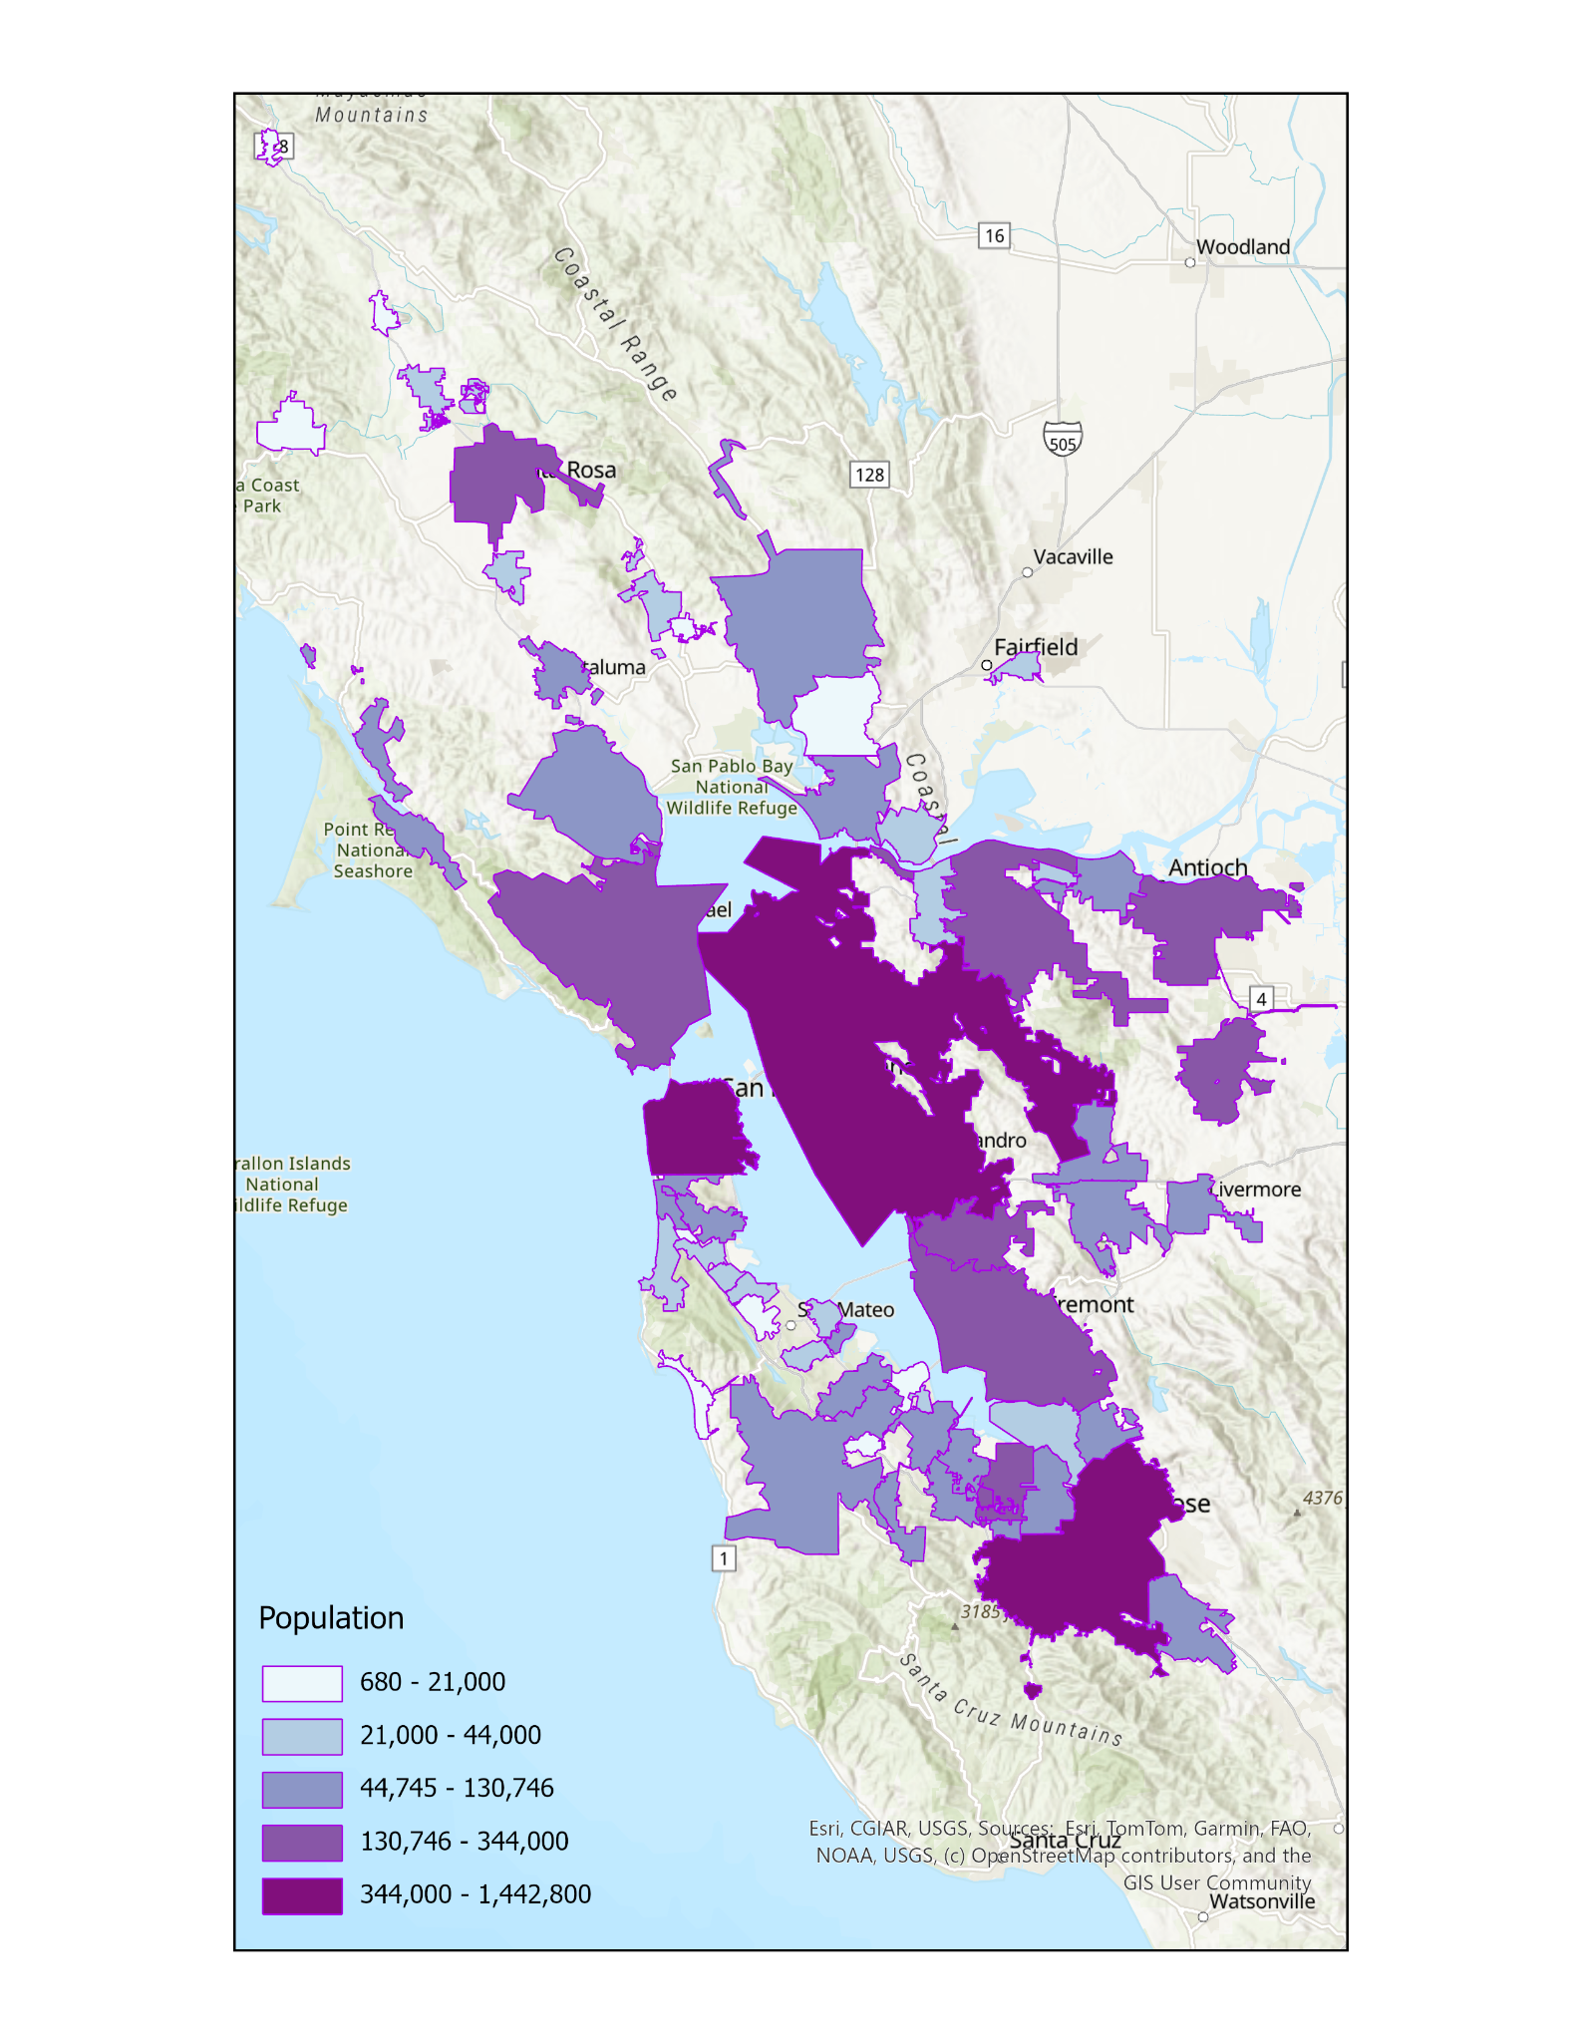
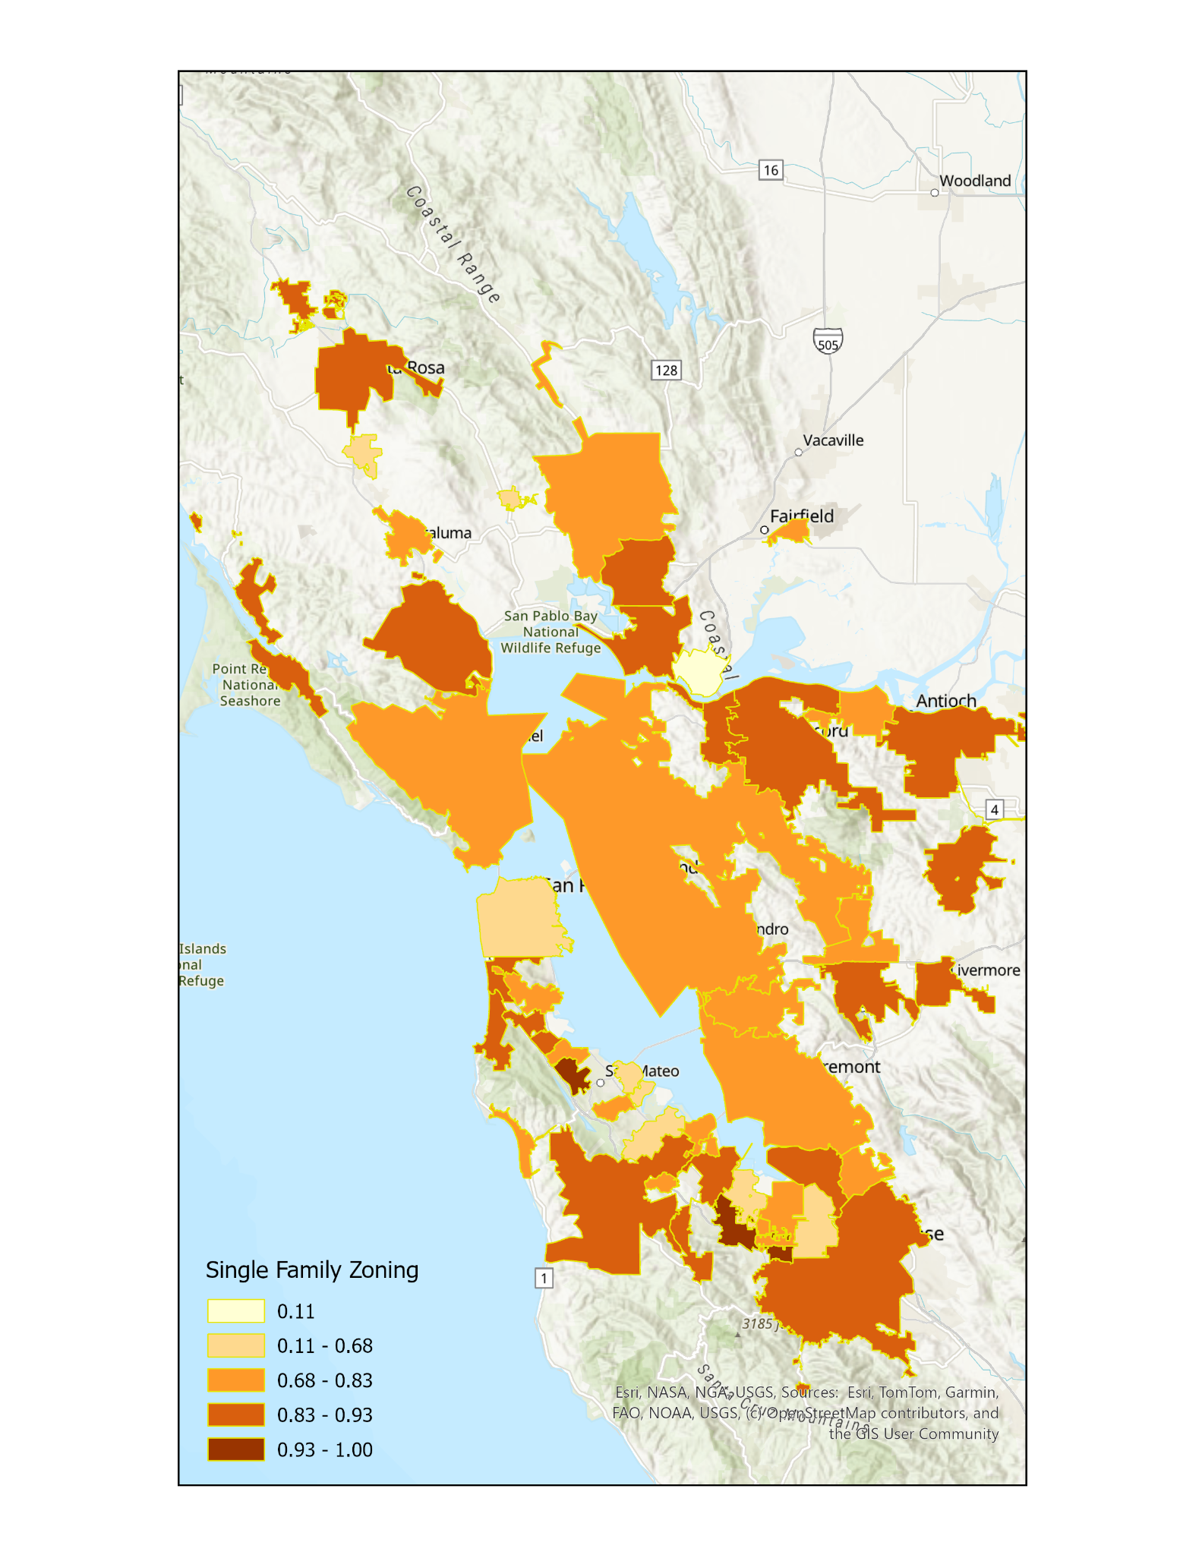
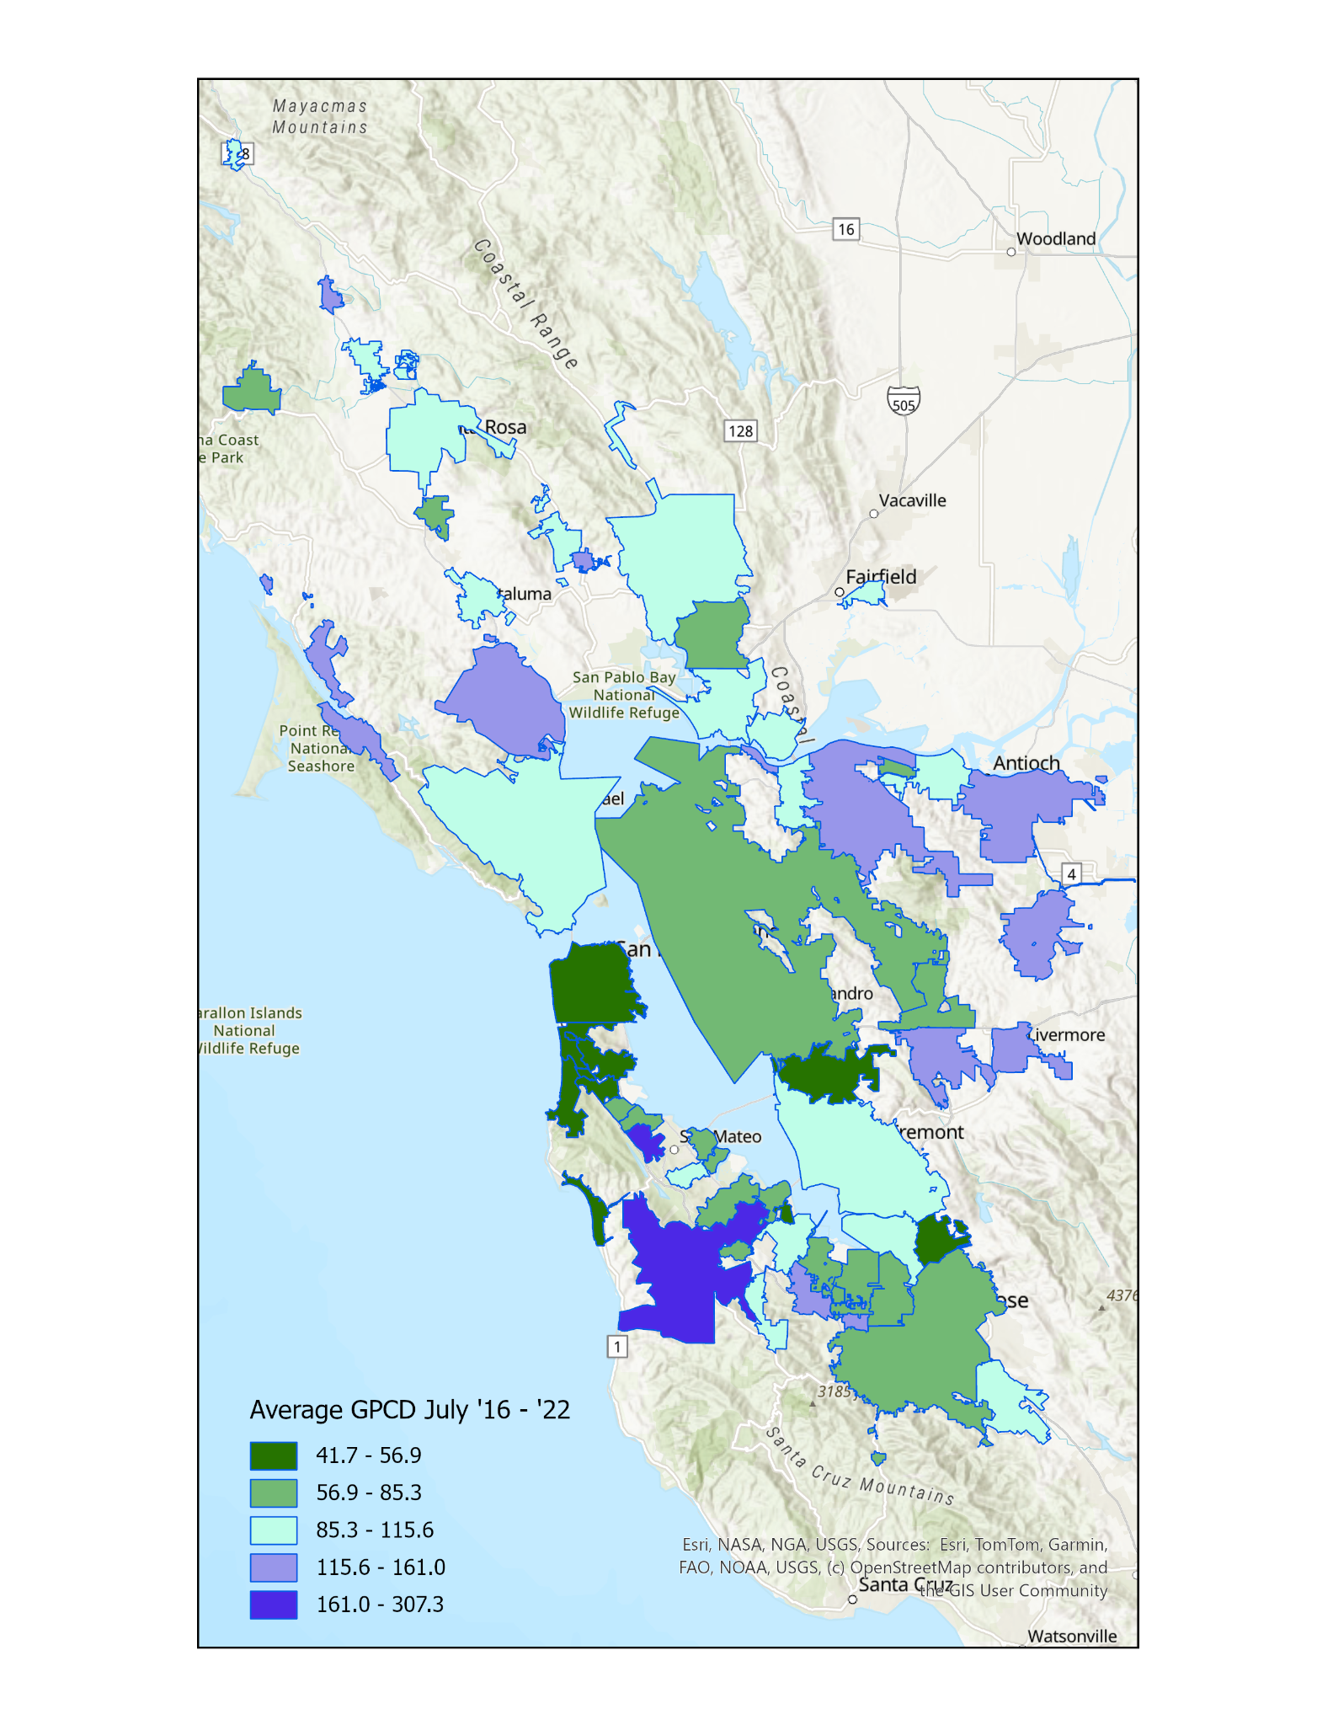
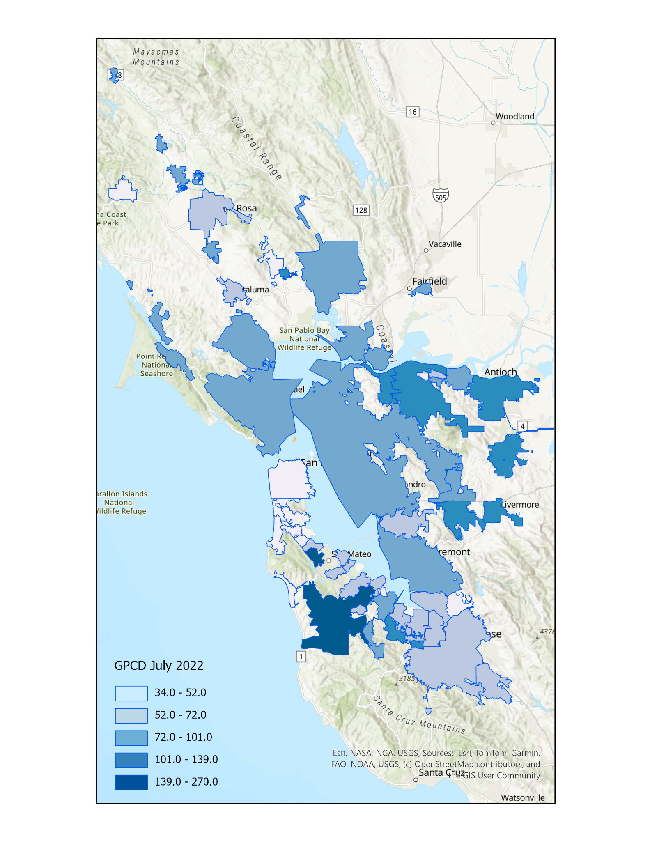
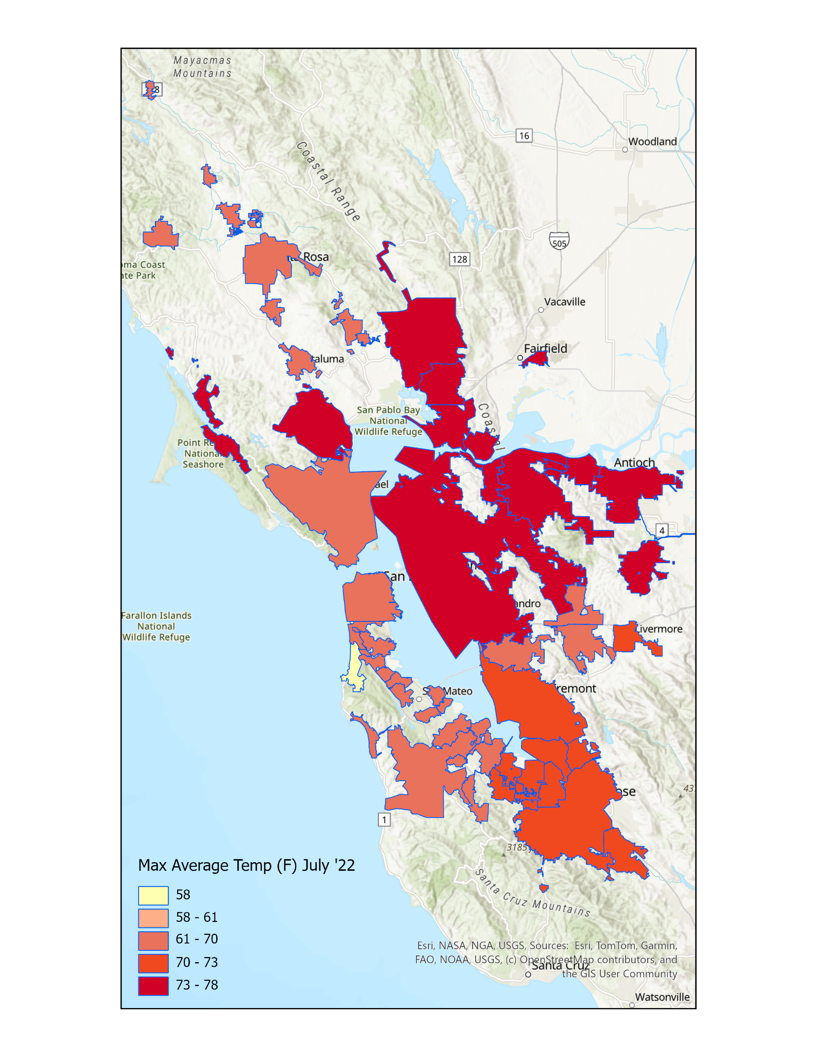
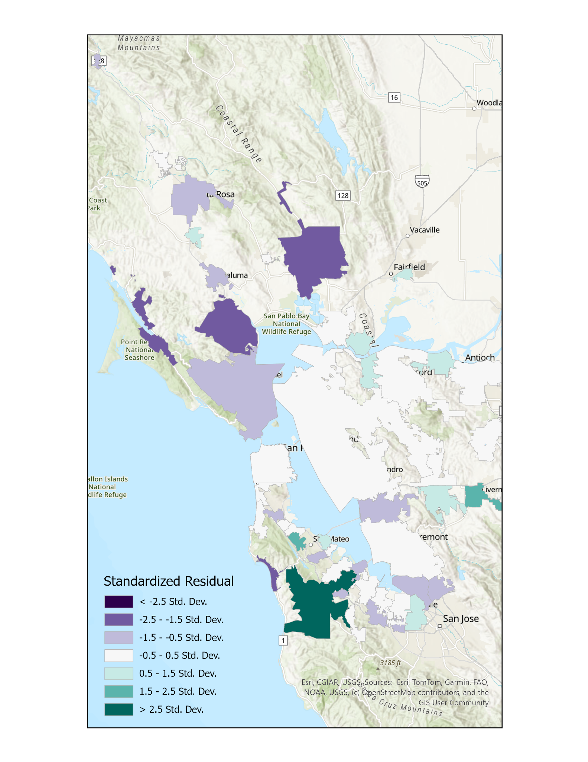
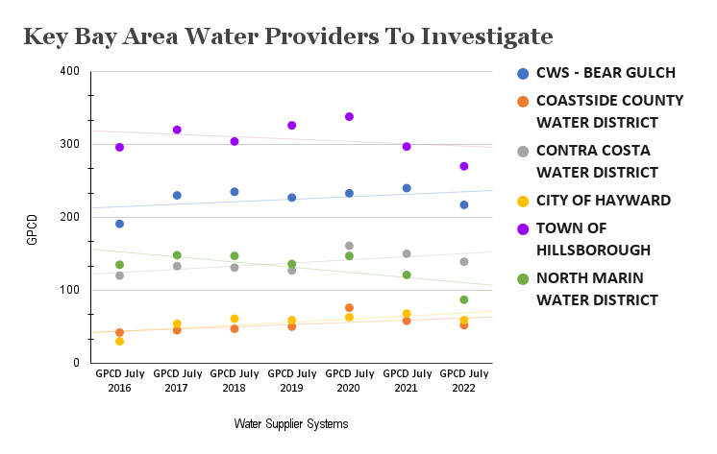
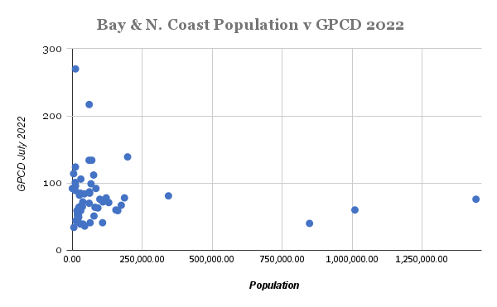
Bay Area & North Coast
Water Use & Planning Policies
By Walter “Shin” Tadokoro
Geography, Environment, and Planning Department
Conclusion
From 2016-2022 Bay Area water systems reduced average residential water consumption by ~12%. Only “Percent of ¼ acre homes” was strongly correlated. Rivers and service connections were ruled out for lack of correlation.
Research Question
Do city policies correlate with a water providers amount of water used?
Methods
To reach consistently recharge aquifers during wet years and responsibly use water during drought requires a holistic knowledge of how our cities use water. Where does it go?
Using SWRCB’s map of water systems and measurements of GPCD, the North Coast and Bay Area was the regional focus.
This research doubles as a proposal to establish ongoing student research into water management and California policy planning, here at SSU.
Variables
The Pacific Institute's “California Urban Water Use”
Maps of Bay Area Zoning by HousingOBI Berkeley
Zillow for housing prices, sales, sizes
Weather station data by WeatherUnderground.com
ArcGIS Online map of all river/stream/creek systems in California.
Shortcomings in GWR Analysis
North Marin (87) and Napa (92) were identified as a significantly below the standard deviation compared to 2022 use levels, however they had average water usage, below average percentage of ¼ acre lots, and average Low Density Zoning.
2022 r squared: 0.32
2022 r squared: 0.01
2022 r squared: 0.05
The providers Westborough WD, Half Moon Bay, Daly City and Hayward practiced extreme efficiency staying in the top 10 every single year ‘16-’22.
Westborough Water averaged 41 gallons (1st)
Daly City averaged gallons (4th)
Coastside WD (HMB) averaged 52 gallons. (9th)
Hayward averaged 56 gallons. (10th)
The Town of Hillsborough and CWS Bear Gulch (Atherton, portions of Menlo Park, Los Trancos, & Portola Valley) were the most liberal water spenders every single year ‘16-’22.
Hillsborough averaged 307 GPCD (59th).
Atherton+ averaged 224 GPCD (58th).
The next worst spender was Sonoma averaging only 161 GPCD (57rd).
Hillsborough: 7th smallest pop at 11,766
Percent of Homes Over ¼ Acre
Population
Low Density Home Zoning
2022 r squared: 0.92
CITY OF PALO ALTO
UKIAH
HEALDSBURG
NORTH MARIN WATER DISTRICT
PLEASANTON
CONTRA COSTA WATER DISTRICT
CALIFORNIA WATER SERVICE - LIVERMORE
CWSC LOS ALTOS SUBURBAN
SONOMA
CALIFORNIA WATER SERVICE - BEAR GULCH
TOWN OF HILLSBOROUGH
Bottom Cities
Top Cities
WESTBOROUGH WATER DISTRICT
SFPUC CITY DISTRIBUTION DIVISION
CWS-
S. SAN FRANCISCO
DALY CITY
EAST PALO ALTO
ARCATA
N. COAST COUNTY WATER DIST
SAN BRUNO
COASTSIDE COUNTY WATER
DISTRICT
CITY OF HAYWARD
2022 r squared: 0.02
Policy Sharing Recommendations
Small towns that wants to maintain small town vibes, and low density, look to Fortuna (96) and Sonoma (42) for guidance on water efficiency policy.
If you are a expanding city that wants guidance on water policy, Hayward and Daly City had GPCDs of 59 and 41 respectively.
Other large, dense metro areas seeking guidance on water efficiency can look towards San Francisco Public Utilities Commission which provided 40 GPCD, to nearly 1 million residents in a densely-built jurisdiction.
2016-2022 Average Water Use
July 2022 Water Use By Water Provider System
Maximum Average Temp
Hillsborough
Geographically Weighted Regression
Bear Gulch
EAST BAY MUD
Contra Costa
Alameda County
San Jose
SFPUC
Notes:
Note: This template is meant only to provide suggestions for a study that follows a typical data collection/analysis/results design. Adapt/change/modify the template to fit your study, as appropriate.

Slide 2
Bay Area & North Coast
Water Use & Planning Policies
By Walter “Shin” Tadokoro
Geography, Environment, and Planning Department
Conclusion
From 2016 to 2022 Bay Area water systems reduced average residential water consumption by ~12%. Only “Percent of ¼ acre homes” was strongly correlated. Rivers and service connections were ruled out for lack of correlation.
2022 r squared: 0.32
2022 r squared: 0.01
2022 r squared: 0.05
Percent of Homes Over ¼ Acre
Population
Low Density Home Zoning
2022 r squared: 0.92
CITY OF PALO ALTO
UKIAH
HEALDSBURG
NORTH MARIN WATER DISTRICT
PLEASANTON
CONTRA COSTA WATER DISTRICT
CALIFORNIA WATER SERVICE - LIVERMORE
CWSC LOS ALTOS SUBURBAN
SONOMA
CALIFORNIA WATER SERVICE - BEAR GULCH
TOWN OF HILLSBOROUGH
Bottom Cities
Top Cities
WESTBOROUGH WATER DISTRICT
SFPUC CITY DISTRIBUTION DIVISION
CWS-
S. SAN FRANCISCO
DALY CITY
EAST PALO ALTO
ARCATA
N. COAST COUNTY WATER DIST
SAN BRUNO
COASTSIDE COUNTY WATER
DISTRICT
CITY OF HAYWARD
2022 r squared: 0.02
2016-2022 Average Water Use
July 2022 Water Use By Water Provider System
Maximum Average Temp
Notes:
Note: This template is meant only to provide suggestions for a study that follows a typical data collection/analysis/results design. Adapt/change/modify the template to fit your study, as appropriate.

Slide 3
2022 r squared: 0.32
2022 r squared: 0.01
Top 10 Systems
WESTBOROUGH WATER DISTRICT
SFPUC CITY DISTRIBUTION DIVISION
CWS-
S. SAN FRANCISCO
DALY CITY
EAST PALO
ALTO
ARCATA
N. COAST COUNTY
WATER DIST
SAN BRUNO
COASTSIDE COUNTY WATER
DISTRICT
CITY OF HAYWARD
2022 r squared: 0.05
CITY OF PALO ALTO
UKIAH
HEALDSBURG
NORTH MARIN WATER DISTRICT
PLEASANTON
CONTRA COSTA WATER DISTRICT
CALIFORNIA WATER SERVICE - LIVERMORE
CWSC LOS ALTOS SUBURBAN
SONOMA
CALIFORNIA WATER SERVICE - BEAR GULCH
TOWN OF HILLSBOROUGH
Bottom 10 Systems
Percent of Homes Over ¼ Acre
Population
Low Density Home Zoning
2022 r squared: 0.92
2022 r squared: 0.02
2016-2022 Average Water Use
July 2022 Water Use By Water Provider System
Maximum Average Temp
Notes:
Note: This template is meant only to provide suggestions for a study that follows a typical data collection/analysis/results design. Adapt/change/modify the template to fit your study, as appropriate.

Slide 4
Bay Area & North Coast
Water Use & Planning Policies
By Walter “Shin” Tadokoro
Geography, Environment, and Planning Department
Conclusion
From 2016-2022 Bay Area water systems reduced average residential water consumption by ~12%. Only “Percent of ¼ acre homes” was strongly correlated. Rivers and service connections were ruled out for lack of correlation.
Research Question
Do city policies correlate with a water providers amount of water used?
Methods
To reach consistently recharge aquifers during wet years and responsibly use water during drought requires a holistic knowledge of how our cities use water. Where does it go?
Using SWRCB’s map of water systems and measurements of GPCD, the North Coast and Bay Area was the regional focus.
This research doubles as a proposal to establish ongoing student research into water management and California policy planning, here at SSU.
Variables
The Pacific Institute's “California Urban Water Use”
Maps of Bay Area Zoning by HousingOBI Berkeley
Zillow for housing prices, sales, sizes
Weather station data by WeatherUnderground.com
ArcGIS Online map of all river/stream/creek systems in California.
GWR Analysis
North Marin (87) and Napa (92) were identified as a significantly below the standard deviation compared to 2022 use levels, however they had average water usage, below average percentage of ¼ acre lots, and average Low Density Zoning.
2022 r squared: 0.32
2022 r squared: 0.01
2022 r squared: 0.05
The providers Westborough WD, Half Moon Bay, Daly City and Hayward practiced extreme efficiency staying in the top 10 every single year ‘16-’22.
Westborough Water averaged 41 gallons (1st)
Daly City averaged gallons (4th)
Coastside WD (HMB) averaged 52 gallons. (9th)
Hayward averaged 56 gallons. (10th)
Percent of Homes Over ¼ Acre
Population
Low Density Home Zoning
The Town of Hillsborough and CWS Bear Gulch (Atherton, portions of Menlo Park, Los Trancos, & Portola Valley) were the most liberal water spenders every single year ‘16-’22.
Hillsborough averaged 307 GPCD (59th).
Atherton+ averaged 224 GPCD (58th).
The next worst spender was Sonoma averaging only 161 GPCD (57rd).
Hillsborough: 7th smallest pop at 11,766
2022 r squared: 0.92
CITY OF PALO ALTO
UKIAH
HEALDSBURG
NORTH MARIN WATER DISTRICT
PLEASANTON
CONTRA COSTA WATER DISTRICT
CALIFORNIA WATER SERVICE - LIVERMORE
CWSC LOS ALTOS SUBURBAN
SONOMA
CALIFORNIA WATER SERVICE - BEAR GULCH
TOWN OF HILLSBOROUGH
Bottom Cities
July 2022 Water Use By Water Provider System
Top Cities
WESTBOROUGH WATER DISTRICT
SFPUC CITY DISTRIBUTION DIVISION
CWS-
S. SAN FRANCISCO
DALY CITY
EAST PALO ALTO
ARCATA
N. COAST COUNTY WATER DIST
SAN BRUNO
COASTSIDE COUNTY WATER
DISTRICT
CITY OF HAYWARD
2022 r squared: 0.02
2016-2022 Average Water Use
Maximum Average Temp
Policy Sharing Recommendations
Small towns that wants to maintain small town vibes, and low density, look to Fortuna (96) and Sonoma (42) for guidance on water efficiency policy.
If you are a expanding city that wants guidance on water policy, Hayward and Daly City had GPCDs of 59 and 41 respectively.
Other large, dense metro areas seeking guidance on water efficiency can look towards San Francisco Public Utilities Commission which provided 40 GPCD, to nearly 1 million residents in a densely-built jurisdiction.
Geographically Weighted Regression
Hillsborough
Bear Gulch
Contra Costa
EAST BAY MUD
Alameda County
San Jose
SFPUC
Notes:
Note: This template is meant only to provide suggestions for a study that follows a typical data collection/analysis/results design. Adapt/change/modify the template to fit your study, as appropriate.

